Slide 1
Digital Image Processing
Associate Prof. Zhang Qingfeng(张庆丰)
Department of Computer Science, Jinan University
Office Room: 415, Nanhailou Building
Email: zqf135@qq.com
1

Slide 2
Chapter 5
Image Restoration and Reconstruction (II)
2

Slide 3
Contents
5. Estimating the Degradation Function
6. Inverse Filtering
7. Minimum Mean Square Error Filtering
8. Constrained Least Squares Filtering
9. Geometric Mean Filter
Summary
3

Slide 4
5. Estimating the Degradation Function
In image restoration, there are three principal ways to estimate the degradation function
1) Observation: laborious, used in very specific circumstances, e.g., restoring an old photograph of historical value
2) Experimentation
3) Mathematical modeling
The image restoration process using an estimated degradation function is sometimes called blind deconvolution

Slide 5
5. Estimating the Degradation Function
Estimation by Image Observation:
Based on the assumption that the image was degraded by LPI (linear, position-invariant)
1) gathering image information from a sub-image g_{s} (x, y) whose signal content is strong (e.g., an area of high contrast)
2) process the su-bimage to arrive at a result as good as possible ,

Slide 6


5. Estimating the Degradation Function
Assuming the effect of noise is negligible in this area:
Then, the degradation function can be deduced by the transfer function of the observed window (under LPI assumption)

Slide 7

5. Estimating the Degradation Function
Estimation by Experimentation
only if the equipment similar to that used to acquire the degraded image is available
1) Obtain image similar to the degraded one by varying system settings until achieving approximately the same degradation level as that of degraded image
2)With such a settings, obtain the impulse response of the degradation by imaging an impulse (small dot of light) with an arbitrary strength A (A is the FT of the impulse)
The degradation function can be deduced by the impulse response of the observed image.

Slide 8
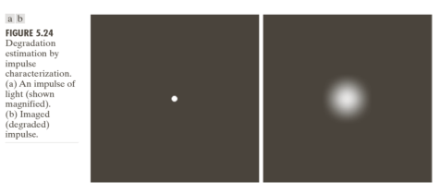
5. Estimating the Degradation Function

Slide 9

5. Estimating the Degradation Function
Estimation by Modeling: Example 1: Atmospheric turbulence model (大气湍流模型)
Degradation modeling has been widely used because of the insight it affords into the image restoration problem.
In some case, the model can even take into account environmental conditions that cause degradation.
For example, the atmospheric turbulence model of Hufnagel and Stanley
where a constant k depends on the nature of the turbulence

Slide 10
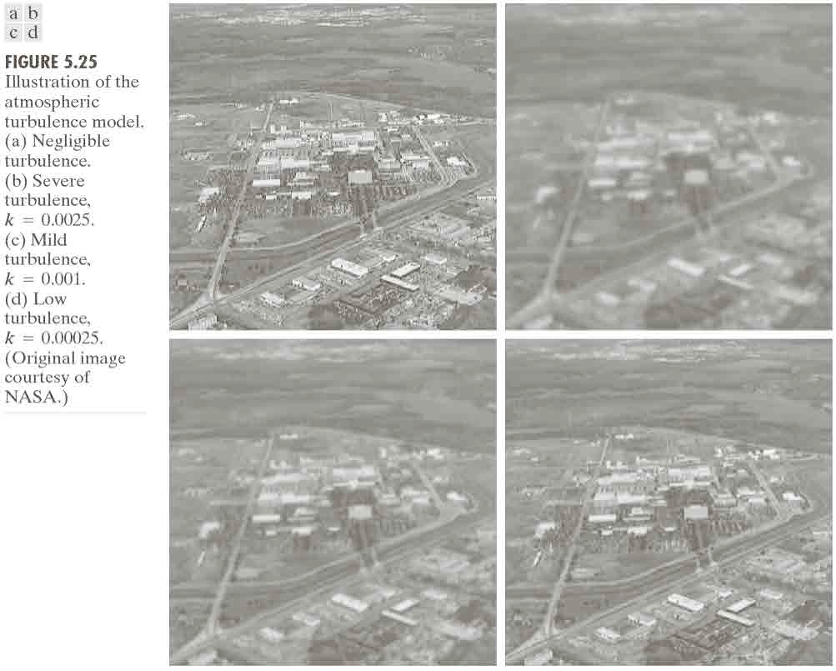

Slide 11
5. Estimating the Degradation Function
Estimation by Modeling: Example 2: Image blurring due to motion
A major approach in modeling is to derive a mathematical model starting from basic principles.
We show this procedure by a case in which an image has been blurred by uniform linear motion between the image and the sensor during image acquisition.

Slide 12
5. Estimating the Degradation Function
Suppose that an image f (x,y) undergoes planar motion and that x₀(t) and y₀(t) are the time-varying components of motion in the x - and y- directions.
The total exposure at any point of the recording medium is obtained by integrating the instantaneous exposure (瞬时曝光) over the time interval when the imaging system shutter is open.
If the T is the duration of the exposure, the blurred image g(x,y) is

Slide 13
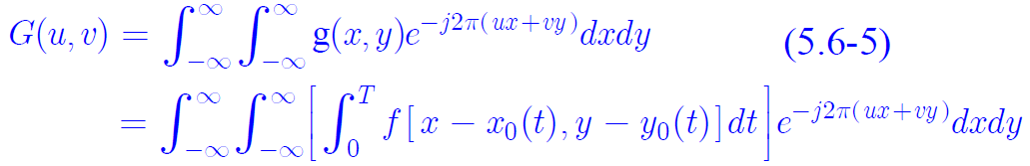
5. Estimating the Degradation Function
the Fourier transform of (5.6-4) is
By reversing the order of integration,

Slide 14
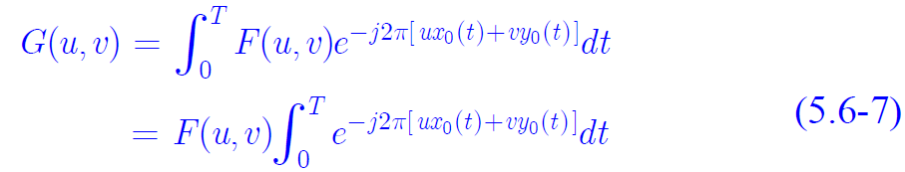
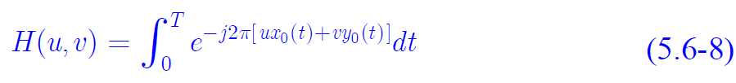
5. Estimating the Degradation Function
Since the term inside the outer brackets is the Fourier transform of the displaced function f [x − x₀(t),y −y₀(t)], we have
By defining

Slide 15
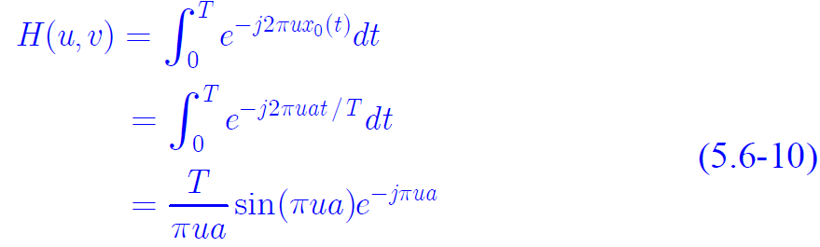
5. Estimating the Degradation Function
we can rewrite (5.6-7) in the familiar form
Suppose that the image in question undergoes uniform linear motion in the x -direction only, at a rate given by x₀(t) = at /T .
When t = T , the image has been displaced by a total distance a. With y₀(t) = 0 , (5.6-8) yields

Slide 16

5. Estimating the Degradation Function
If we allow the y-component to vary as well, with the motion given by y₀(t) = bt /T , the degradation function becomes
Figure 5.26 (b) is an image blurred by computing the Fourier transform of the image in Figure 5.26 (a), multiplying the transform by H (u,v ) from (5.6-11).
The parameters used in (5.6-11) were a = b = 0.1 and T = 1

Slide 17
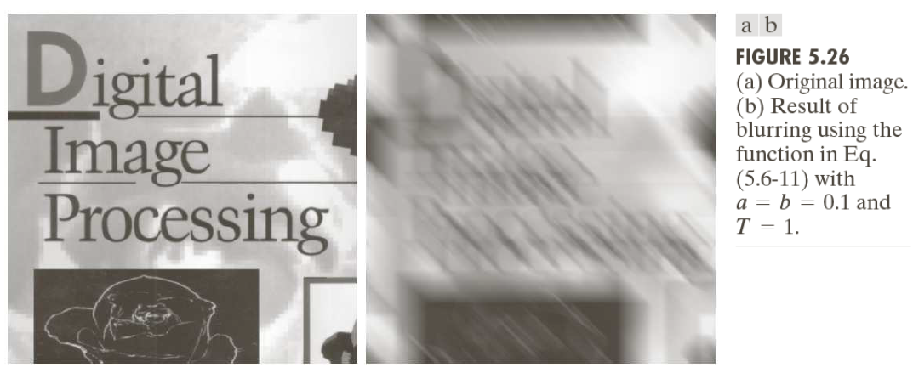
5. Estimating the Degradation Function

Slide 18


6. Inverse Filtering
If H is given or estimated, the simplest approach to restoration is direct inverse filtering
Even if H is completely known, F cannot be exactly recovered because N is not known.
If H has zero or very small values, the ratio N/H may predominate. One approach to get around this is to limit the filter frequencies to values near the origin.

Slide 19
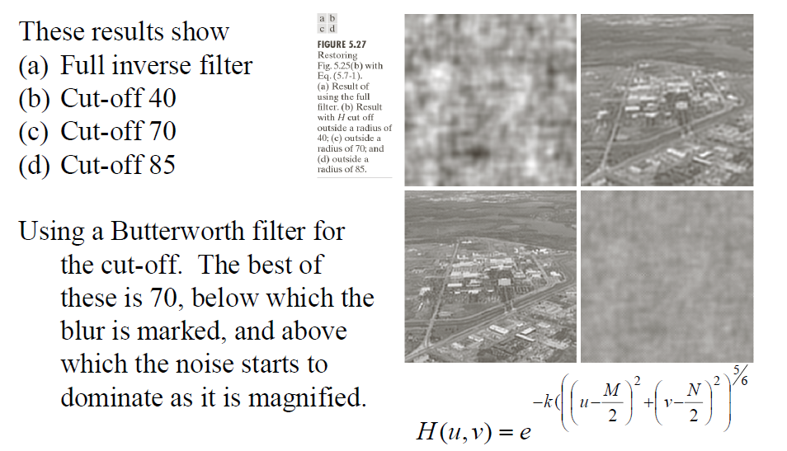
6. Inverse Filtering

Slide 20
7. Minimum Mean Square Error (Wiener) Filtering
Traditional inverse filtering makes no explicit provision for handling noise.
In this section, an approach incorporating both the degradation and statistical characteristic of noise is discussed.

Slide 21

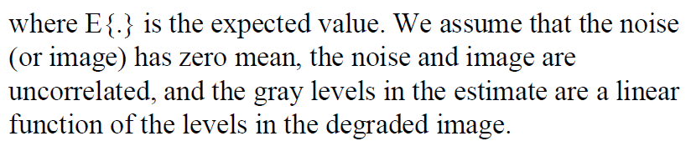
7. Minimum Mean Square Error (Wiener) Filtering
Objective of this approach is to find an estimate of uncorrupted image such that the mean square error (MSE) between the uncorrupted image f and an estimate is minimized.

Slide 22
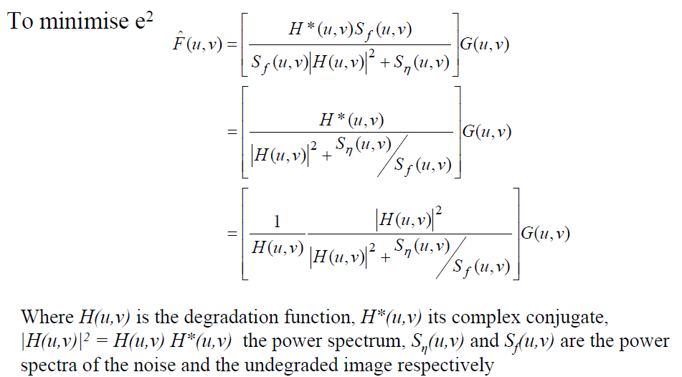
7. Minimum Mean Square Error (Wiener) Filtering

Slide 23
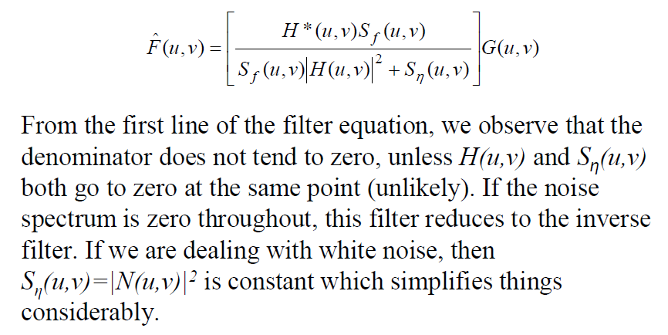
7. Minimum Mean Square Error (Wiener) Filtering

Slide 24
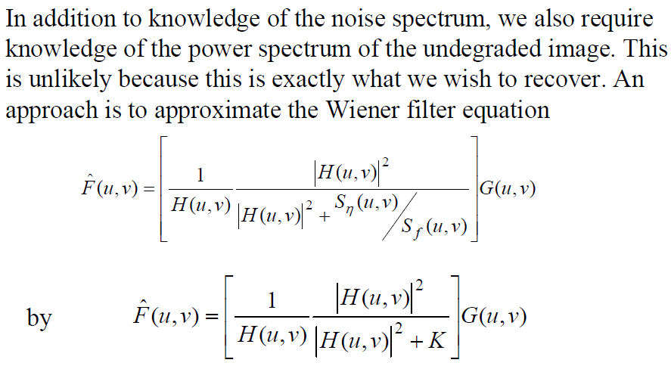
7. Minimum Mean Square Error (Wiener) Filtering

Slide 25
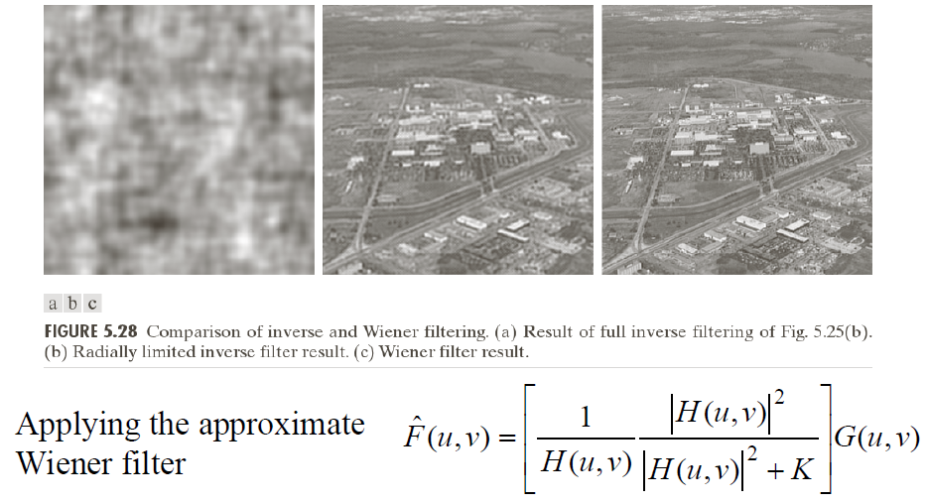
7. Minimum Mean Square Error (Wiener) Filtering

Slide 26
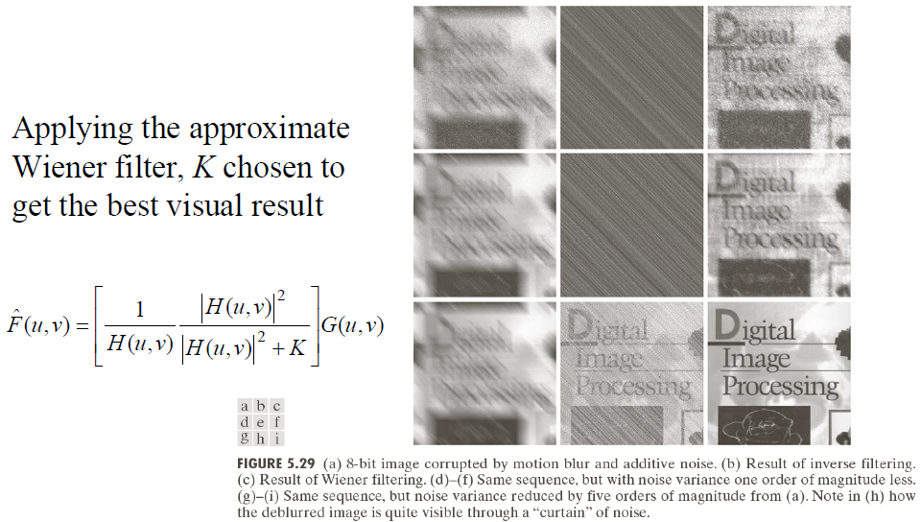
7. Minimum Mean Square Error (Wiener) Filtering

Slide 27
8. Constrained Least Squares Filtering
Drawback of Wiener filtering:
Need to know the power spectrum of the original image, S_{f} (u,v) and S_{η}(u,v), (difficult)
Or, need to use a constant estimate of the ratio of power spectra (before and after degradation) (not very reasonable)
Minimization of → optimal in an average sense
This method:
Only requires mean and variance of noise (more reasonable)
Optimization for each image 

Slide 28
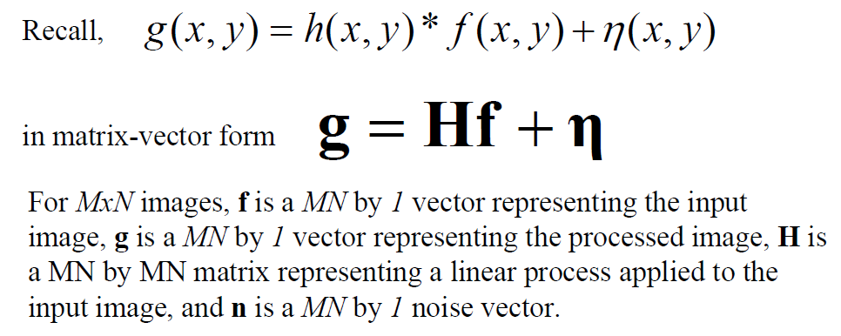
8. Constrained Least Squares Filtering

Slide 29
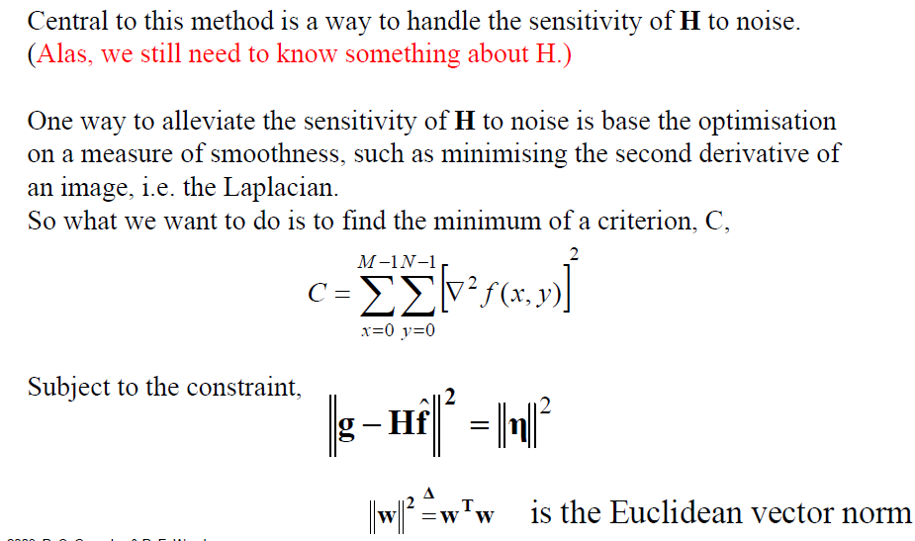
8. Constrained Least Squares Filtering

Slide 30
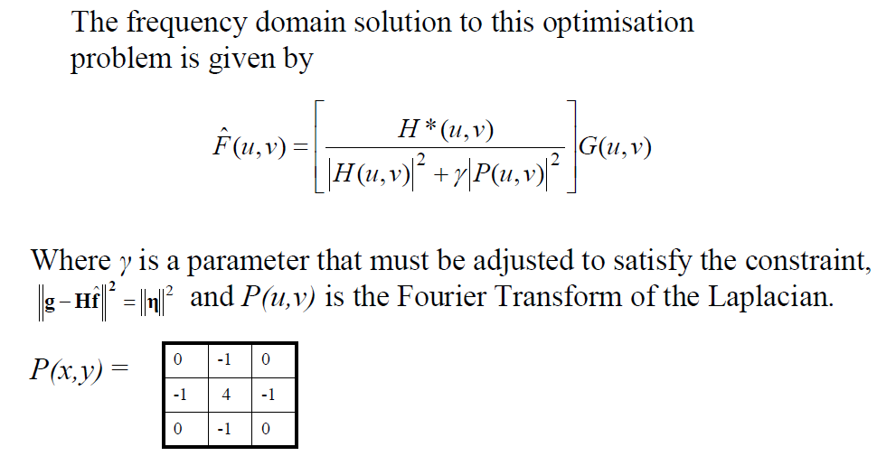
8. Constrained Least Squares Filtering

Slide 31
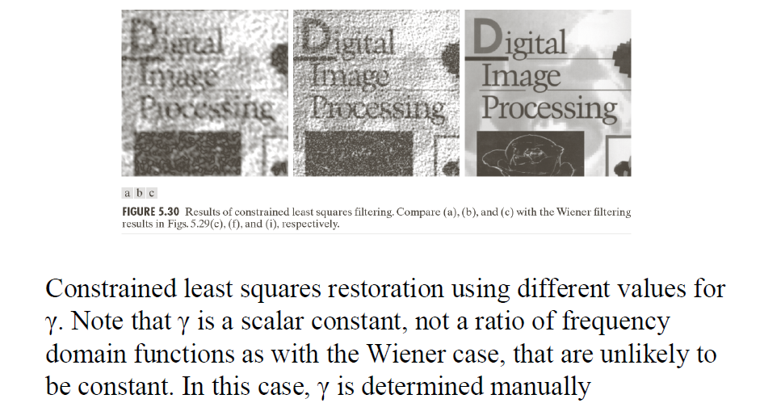
8. Constrained Least Squares Filtering

Slide 32
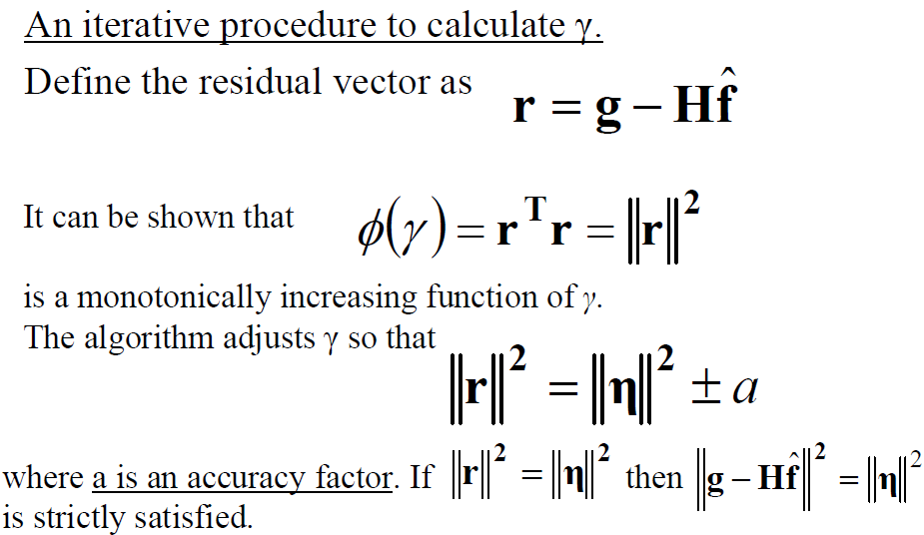
8. Constrained Least Squares Filtering

Slide 33
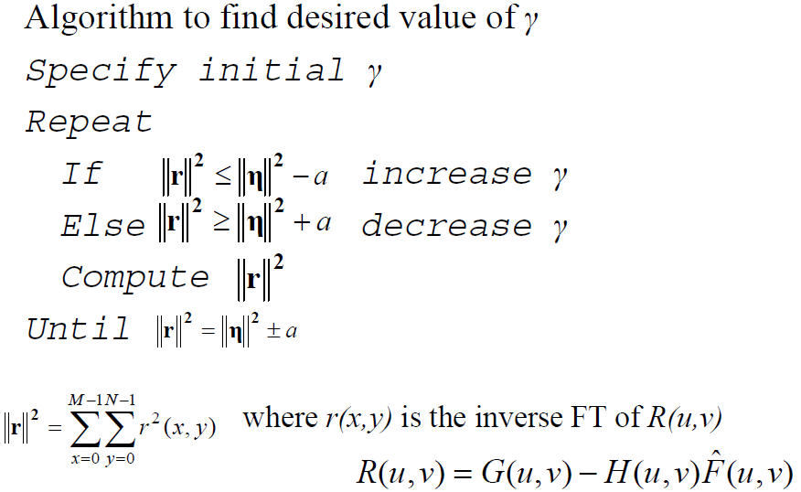
8. Constrained Least Squares Filtering

Slide 34
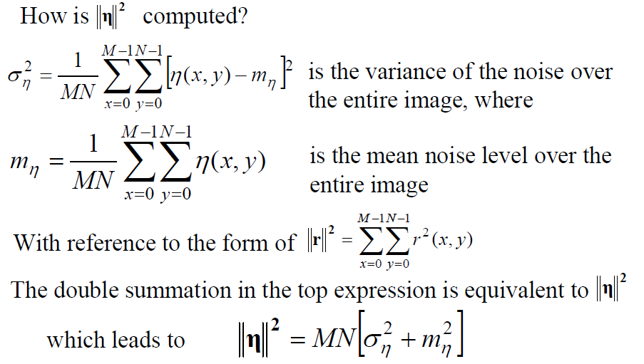
8. Constrained Least Squares Filtering

Slide 35
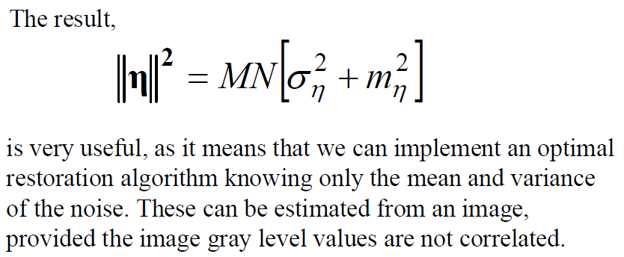
8. Constrained Least Squares Filtering

Slide 36
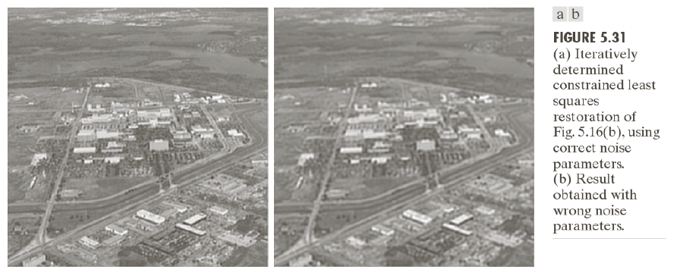
8. Constrained Least Squares Filtering

Slide 37
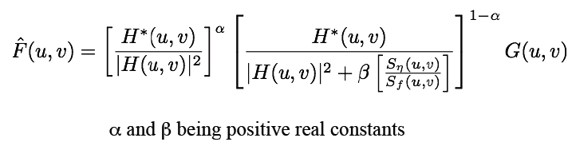
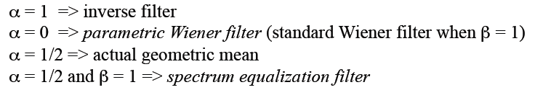
9. Geometric Mean Filter
Generalization of the Wiener filter:

Slide 38
Summary
In this lecture, we have learned
Estimating the Degradation Function
Inverse Filtering
Minimum Mean Square Error Filtering
Constrained Least Squares Filtering
Geometric Mean Filter
38

Slide 39
Homeworks
Page 412
Problems 5.10, 5.12
Page 414
problem 5.26
39

